Slide 1

ABC Call Volume Trend Analysis Final Project-4
By – Anindya Das

Slide 2
Project analysis slide 2
Project Flow
Project Description
Business Understanding
PROJECT
Insights
Tasks
Tech Stack Used
Approach

Slide 3
PROJECT DESCRIPTION
A CX team analyzes customer feedback and data, sharing insights with the organization They perform various roles, including CX programs, digital customer experience, design, internal communications, voice of the customer, user experiences, journey mapping, customer success, customer support, data handling, and learning about the customer journey.
AI-empowered customer experience tools, such as Interactive Voice Response (IVR), Robotic Process Automation (RPA), predictive analytics, and intelligent routing, can significantly impact customer service. The Customer Experience team offers numerous employment opportunities for customer service representatives, including email, inbound, outbound, and social media support. Inbound customer support involves handling incoming calls from existing or prospective customers, attracting, engaging, and delighting them to become loyal advocates By solving customer problems and helping them achieve success, businesses can delight customers and grow their business.

Slide 4
BUSINESS UNDERSTANDING
Advertising is a marketing strategy to increase sales and raise awareness of a business's products or services. It shapes the first impressions customers have before making a purchase. Businesses can target different audiences—local, regional, national, or international—using various methods, including internet directories, trade publications, radio, cinema, outdoor ads, national newspapers, magazines, and television. The advertising industry is highly competitive, with many companies vying for the same audience. To succeed, businesses must use analytical skills to effectively target these audiences across various media platforms while converting them into customers at a low cost.

Slide 5
APPROACH
Data Cleaning: To ensure accurate and meaningful analysis, I performed data cleaning. This involved removing unnecessary columns that were not relevant to the tasks at hand. By cleaning the data, I obtained a clean dataset that served as the basis for my analysis.
Data Analysis: Using Excel, I explored the data analysis part of the project. For each task, I utilized pivot tables and graphs to perform the required calculations and generate insights. This allowed me to extract valuable information and patterns from the data set.

Slide 6
TECH-STACK USED
Microsoft Excel: Used for data analysis, manipulation, and visualization. Excel provides various functionalities for working with data, including formulas, charts, and pivot tables.
Microsoft Excel

Slide 7
ASSUMPTIONS
An agent works for 6 days a week; On average, each agent takes 4 unplanned leaves per month; An agent's total working hours are 9 hours, out of which 1.5 hours are spent on lunch and snacks in the office. On average, an agent spends 60% of their total actual working hours (i.e., 60% of 7.5 hours) on calls with customers/users. The total number of days in a month is 30.

Slide 8
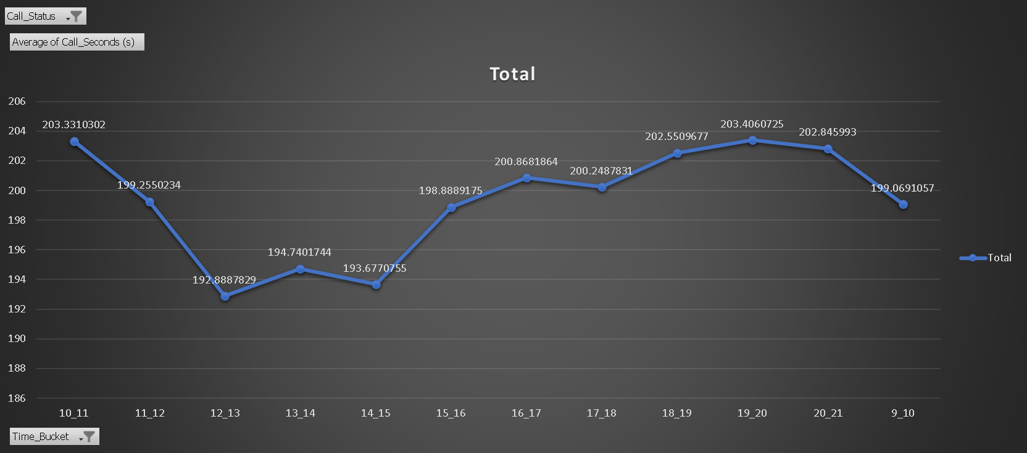
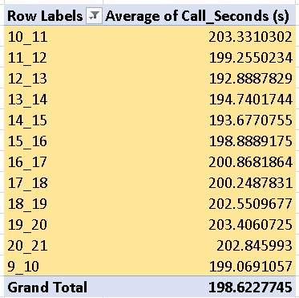
Data Analytics Tasks:
Average Call Duration: Determine the average duration of all incoming calls received by agents. This should be calculated for each time bucket.
Your Task: What is the average duration of calls for each time bucket?

Slide 9
INSIGHTS
An Overall Increasing Trend from 9 am to 9 pm with an average duration of 198.62 seconds
lowest during 12 pm to 1 pm slot followed by 2 pm to 3 pm then 1 pm to 2 pm
Longest duration during 10 am to 11 am followed by 8 pm to 9 pm then 7 pm to 8 pm
In morning hours from 9 am to 12 pm and from 6 pm to 9 pm the call duration is highest

Slide 10
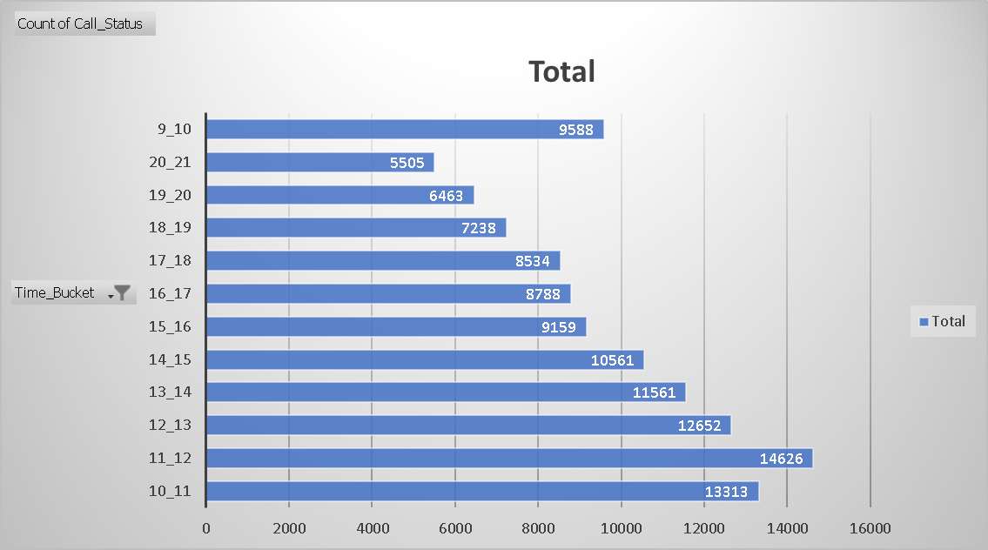
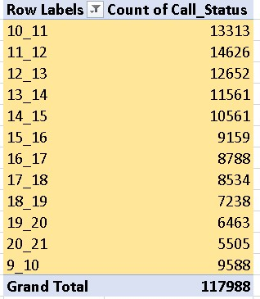
Call Volume Analysis: Visualize the total number of calls received. This should be represented as a graph or chart showing the number of calls against time. Time should be represented in buckets (e.g., 1-2, 2-3, etc.).
Your Task: Can you create a chart or graph that shows the number of calls received in each time bucket?

Slide 11
INSIGHTS
The Call volume follows a left-skewed bell curve, with the 9588 at 9 am to 10 am peaking at 11 to 12 with 14626 then continuously declining to 5505 in 8 pm to 9 pm slot
Overall decreasing trend is followed
During the initial number of hours large number of calls are abandoned, and during the last hour large number of calls are abandoned in comparison to the call answered
During the day more than 11 lakh calls are received

Slide 12
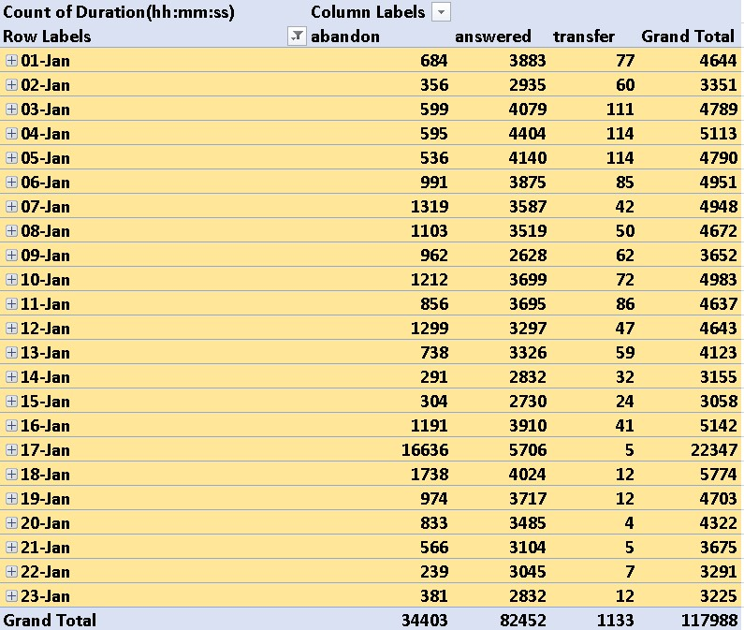
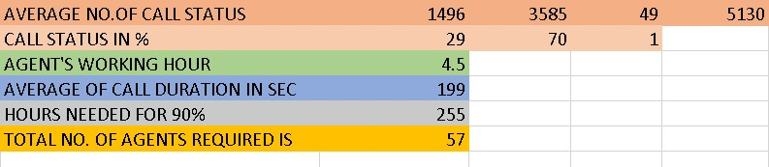
Manpower Planning: The current rate of abandoned calls is approximately 30%. Propose a plan for manpower allocation during each time bucket (from 9 am to 9 pm) to reduce the abandon rate to 10%. In other words, you need to calculate the minimum number of agents required in each time bucket to ensure that at least 90 out of 100 calls are answered.
Your Task: What is the minimum number of agents required in each time bucket to reduce the abandon rate to 10%?

Slide 13
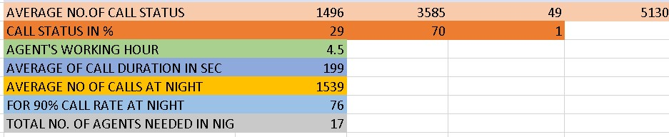
Night Shift Manpower Planning: Customers also call ABC Insurance Company at night but don't get an answer because there are no agents available. This creates a poor customer experience. Assume that for every 100 calls that customers make between 9 am and 9 pm, they also make 30 calls at night between 9 pm and 9 am. The distribution of these 30 calls is as follows:
Your Task: Propose a manpower plan for each time bucket throughout the day, keeping the maximum abandon rate at 10%.

Slide 14
RESULT
The project helped in understanding how to analyze call center data and make effective insights
Further strengthening of understanding of Charts and Pivot tables in Excel.
The project helped in giving a glimpse of a high-stakes problem where customer satisfaction and profitability need to be kept in mind along with how the jobs of people are in balance. The Project helps in understanding how to handle this.
Dataset: https://docs.google.com/spreadsheets/d/1AeMYVz1y-s5hlCghoPaGncgOdWfS9bEA/edit?usp=drive_link&ouid=100865564169059724511&rtpof=true&sd=true

Slide 15
Thank You!

